Slide 1
Annexations
Town & Village of Orchard Park
Joint Meeting
Public Hearing
November 13, 2023

Slide 2
Why are we doing this?
To charge all residents for services in the same manner
There are 130 parcels currently proposed for annexation
25 from the Village into the Town
105 from the Town into the Village
Why are we annexing these parcels?:
Many are split parcels
Some are parcels whose driveways enter another municipality.
Some are parcels receiving out of district services.
There are some where parcels are proposed to be annexed to complete a service area.
These annexations have been given a great amount of scrutiny to create municipal boundaries that service its residents and property owners in the most efficient and fiscally responsible manner.

Slide 3
How did the Boundary Problem Develop?
The Village was established over 100 years ago. At that time, there were larger plots of land and as they were sold off and developed, some were divided by municipal borders.
Some parcels have been developed at the end of a road that is serviced by another municipality, parcels were split and merged, roads were established and some extended.
Other parcels have been connected to another municipality’s water system.
Changes to the municipal boundaries have been discussed in the past, but no action was taken.
It is a huge undertaking! But the Town and Village are determined to work together to resolve the issues and develop a boundary to serve our residents effectively.

Slide 4
Positive Impact
This will help both the Town and Village streamline services
It will also provide services to the taxpayers justly
Services being considered:
Collection of Garbage & Recycling
Water System
Street Plowing & Salting
Brush & Leaf Collection
Code Enforcement
Maintenance & Upkeep of Roads

Slide 5
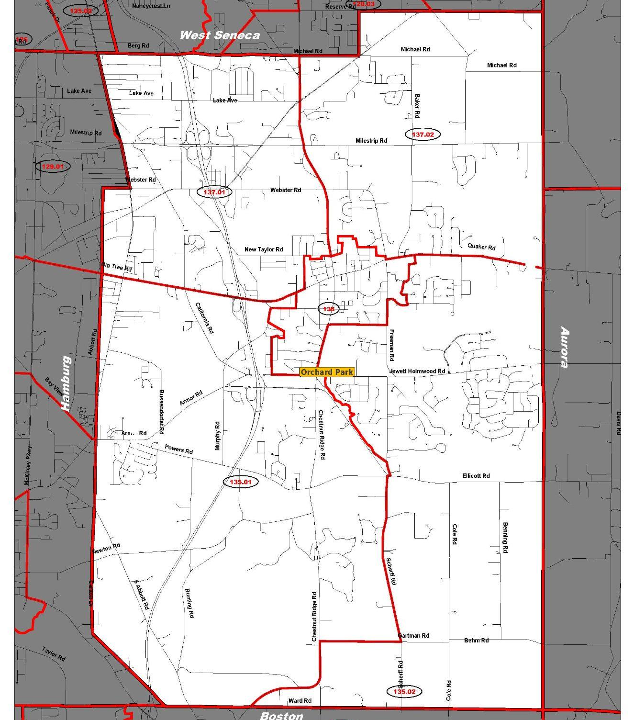
The Annexation Process
Identify parcels to be annexed
Hold a Public Hearing
Within 90 days vote if the annexations are in the overall public interest
Waivers from Property Owners to be returned within 90 days
Annexations filed with Village/Town/County/State
Zoning

Slide 6
Town & Village of Orchard Park
Joint Meeting
Public Hearing
November 13, 2023

